Slide 1




Advanced Excel Formulas, Tips, and Hacks
Boost Productivity & Work Smarter
Slide created by___Jay Shinde

Slide 2
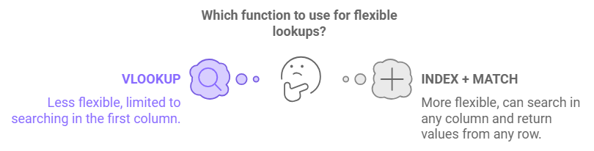
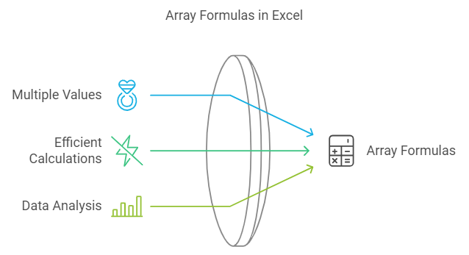
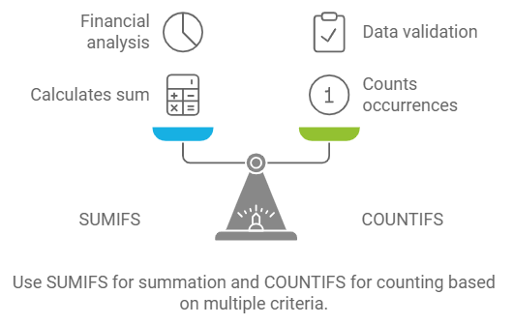
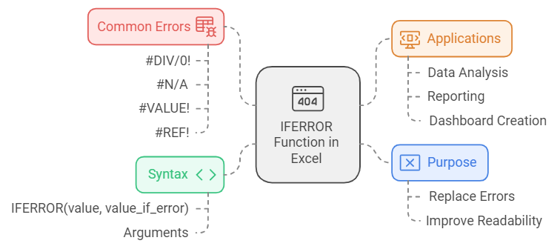
Advanced Excel Formulas
INDEX + MATCH: More flexible than VLOOKUP. Use INDEX to return a value from a specific row and column, and MATCH to identify the position in the range.
ARRAY FORMULAS: Handle multiple values at once. Example: {=SUM(A1:A10*B1:B10)} for summing product of two ranges.
SUMIFS and COUNTIFS: Calculate sum and count based on multiple criteria for better data analysis.
IFERROR: Simplify error handling by replacing errors with specific values (e.g., NA).

Slide 3
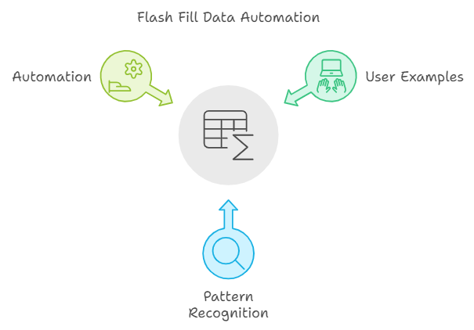
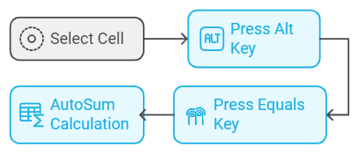
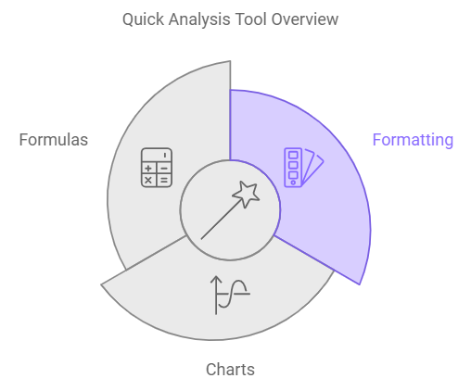
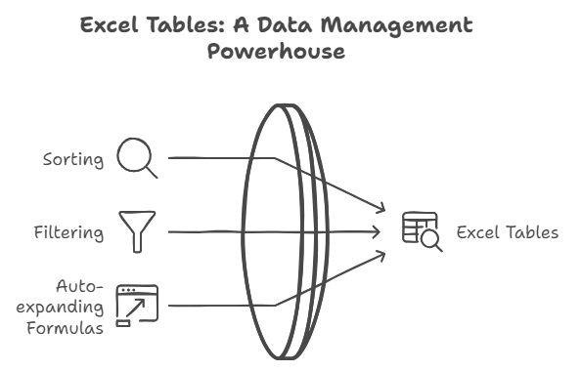
Time-Saving Excel Tips
Flash Fill: Quickly fill data following a pattern by typing a few examples (Ctrl + E).
Quick Analysis Tool: Select a range, then press Ctrl + Q to apply formatting, charts, or formulas with one click.
AutoSum Shortcut: Press Alt + = to instantly sum a column or row.
Excel Tables: Turn your data into tables (Ctrl + T) to enable easier sorting, filtering, and auto-expanding formulas.

Slide 4
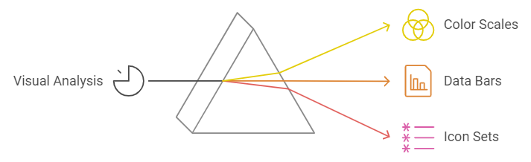
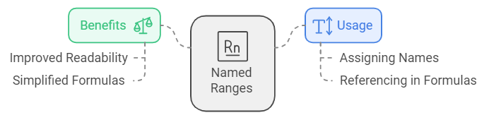
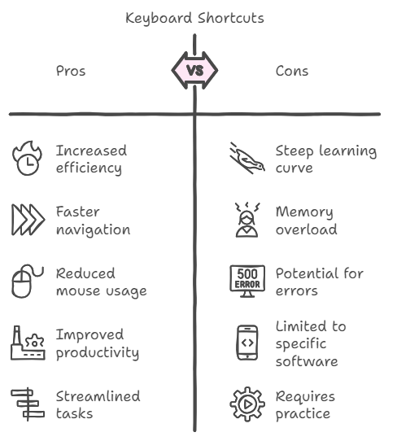

Excel Hacks for Productivity
Conditional Formatting: Highlight key data by using color scales, data bars, and icon sets for better visual analysis.
Macros: Automate repetitive tasks by recording macros (Alt + F11 to access VBA editor).
Named Ranges: Assign names to ranges for better readability and simpler formula referencing.
Keyboard Shortcuts: Memorize key shortcuts like Ctrl + Shift + L (Toggle filters), and Ctrl + Space (Select column).

Slide 5
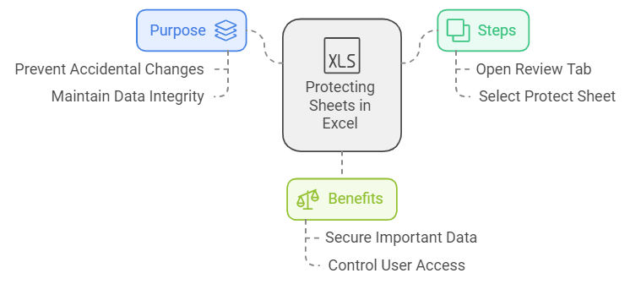
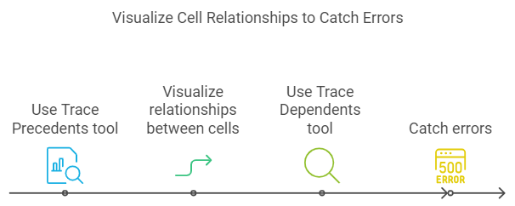
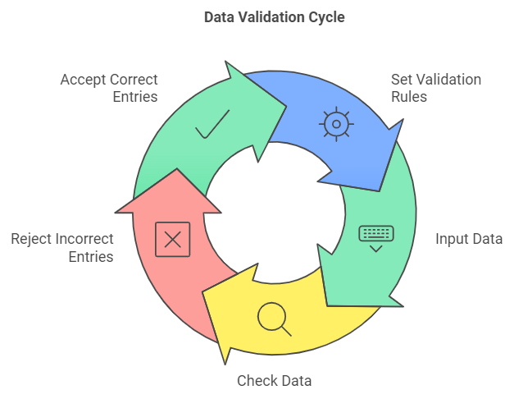
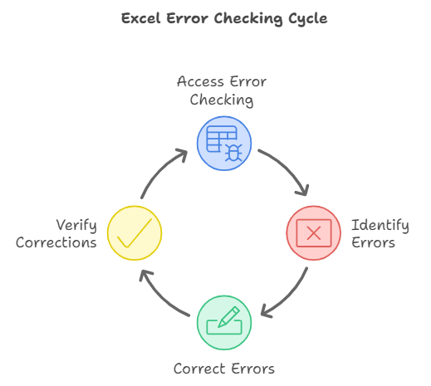
Tips for Error-Free Excel Work
Data Validation: Prevent incorrect entries by setting data validation rules (e.g., restrict input to numbers).
Trace Precedents and Dependents: Use these tools to visualize relationships between cells and catch errors (Alt + M + P).
Error Checking: Use Excel’s error checking feature to catch issues early (Formulas tab > Error Checking).
Protect Sheets: Lock cells that shouldn’t be edited (Review tab > Protect Sheet).

Slide 6
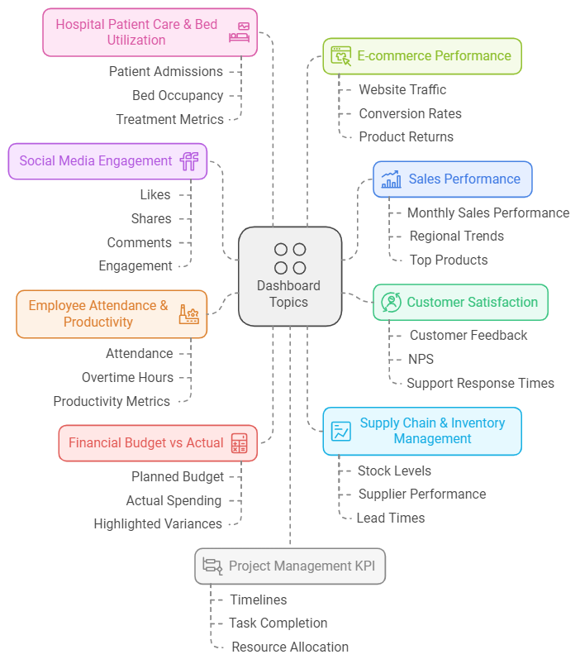
Dash – o – thon
Instructions:
Pick any topic of your choice.
Conduct research and development on the selected topic and gather relevant information.
Collect data as much as possible related to the topic.
Create a visualization dashboard using the collected data.
Write a detailed analysis around your work, offering insights and sharing a storyline.
Suggest Scope for process improvement based on your findings.

Slide 7
T h a n k
Y o u !
Advance Excel Formulas, Tips, and Hacks to Increase Productivity
Slide Generated on 06th October 2024
Slide Generated by _ Jay Shinde

